Slide 1
2019 Phoenix AG Highlights
Mensa Program Meeting
January 11, 2020

Slide 2
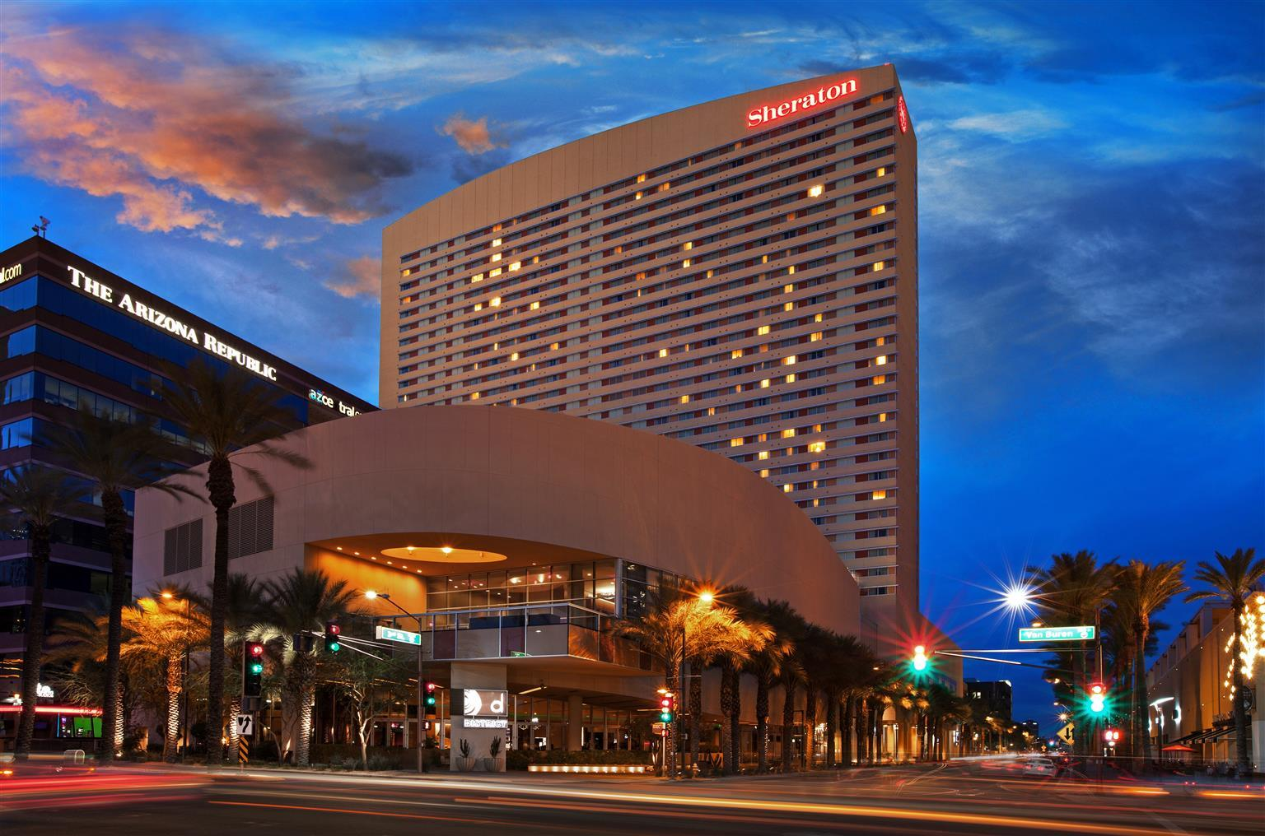
.

Slide 3
The 2019 AG met in Phoenix, AZ, July 3 ‒ 7, 2019. The AG was hosted by the Sheraton Grand Hotel, a very spacious and attractive facility, located downtown Phoenix. The AG attendance was about 2,000.

Slide 4
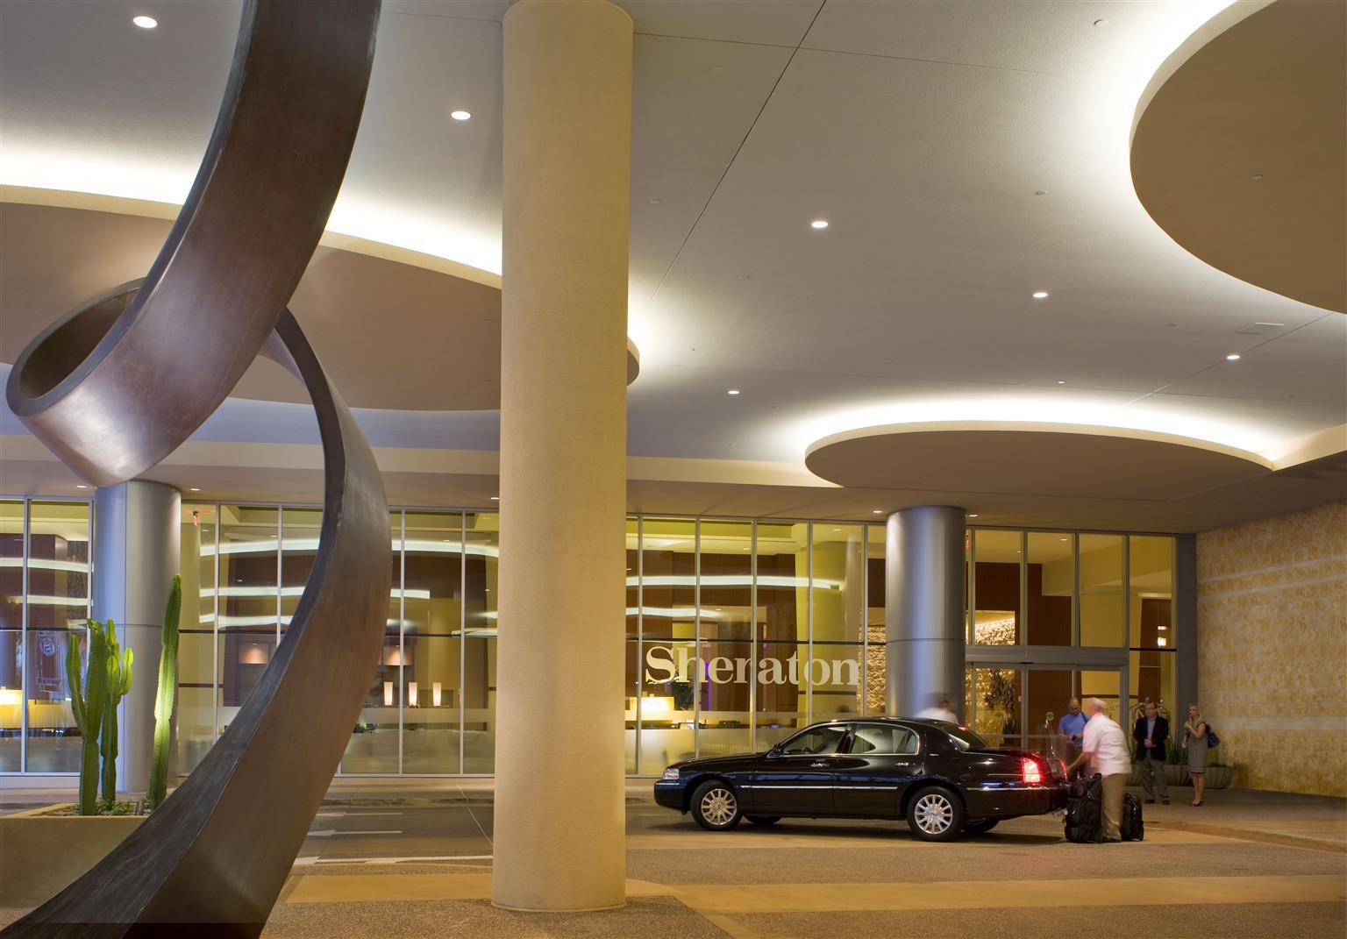

Slide 7
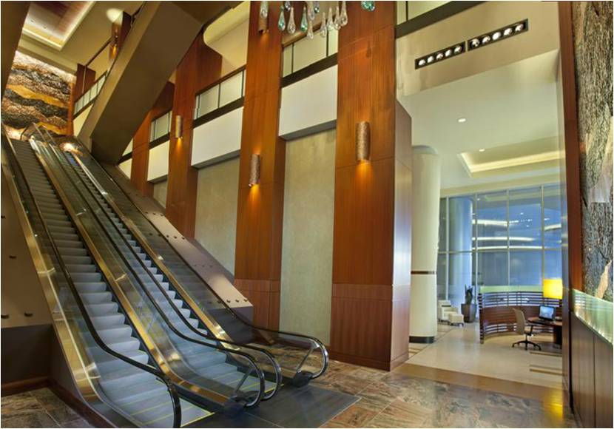

Slide 8
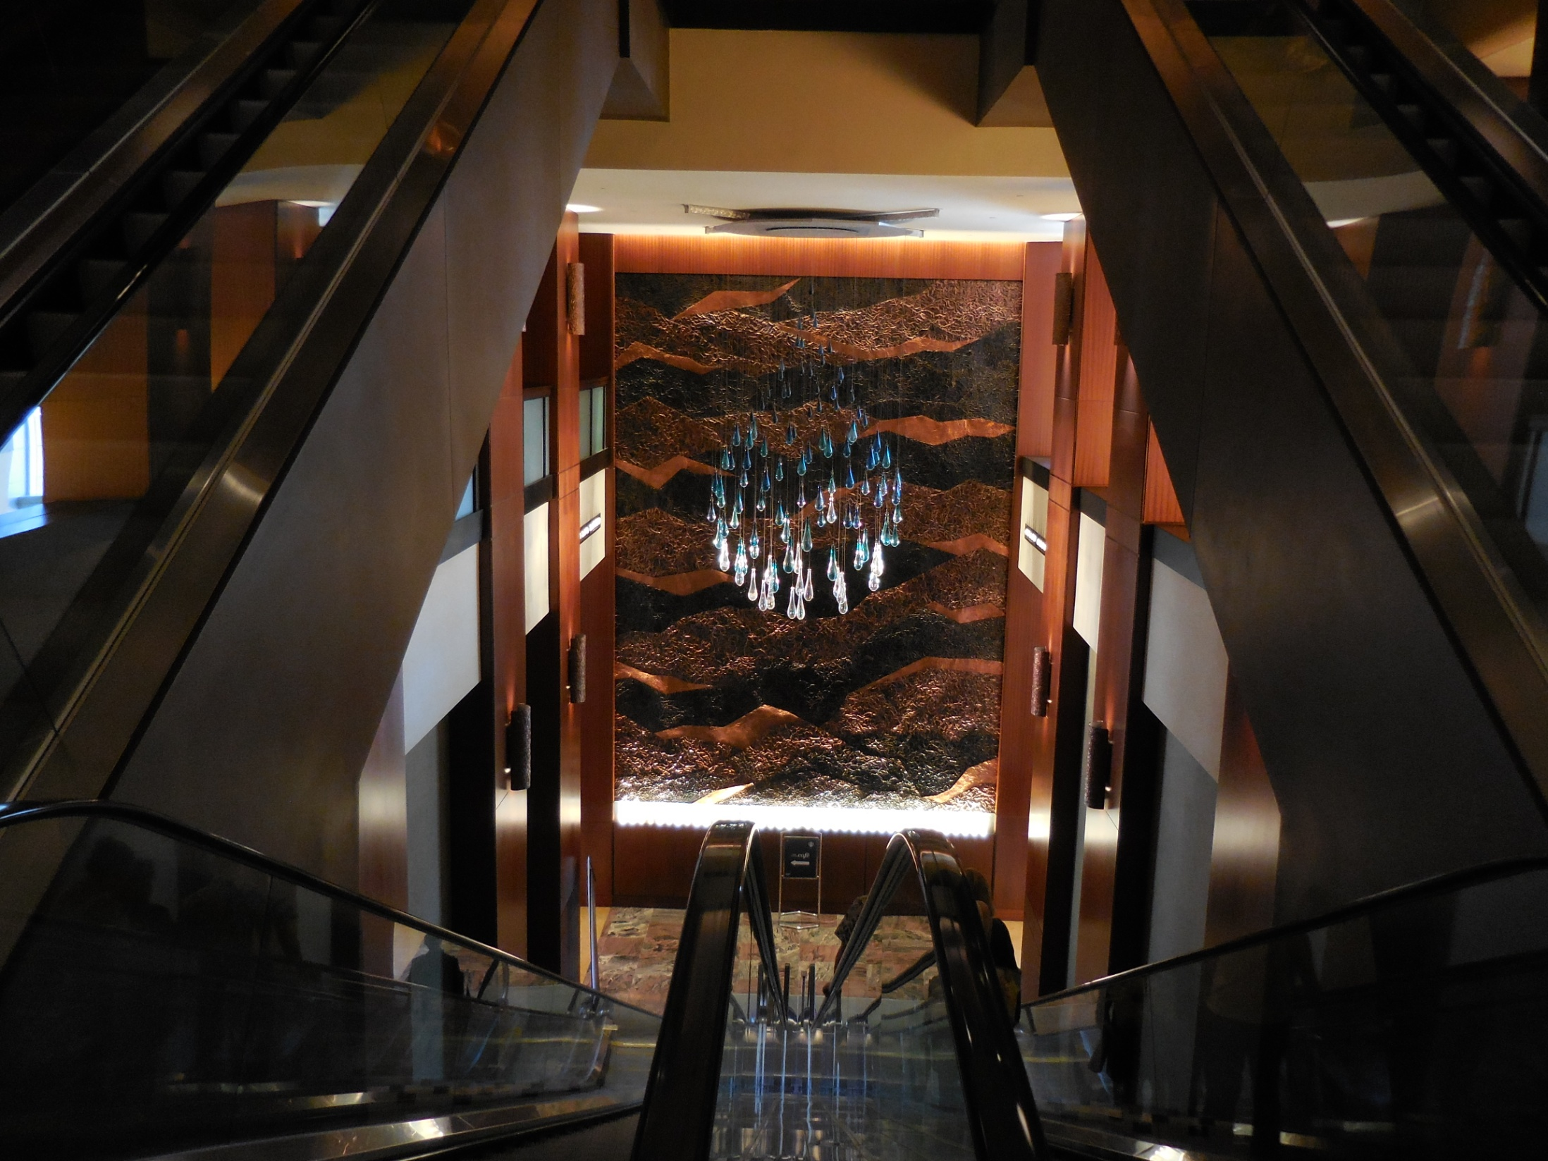

Slide 9
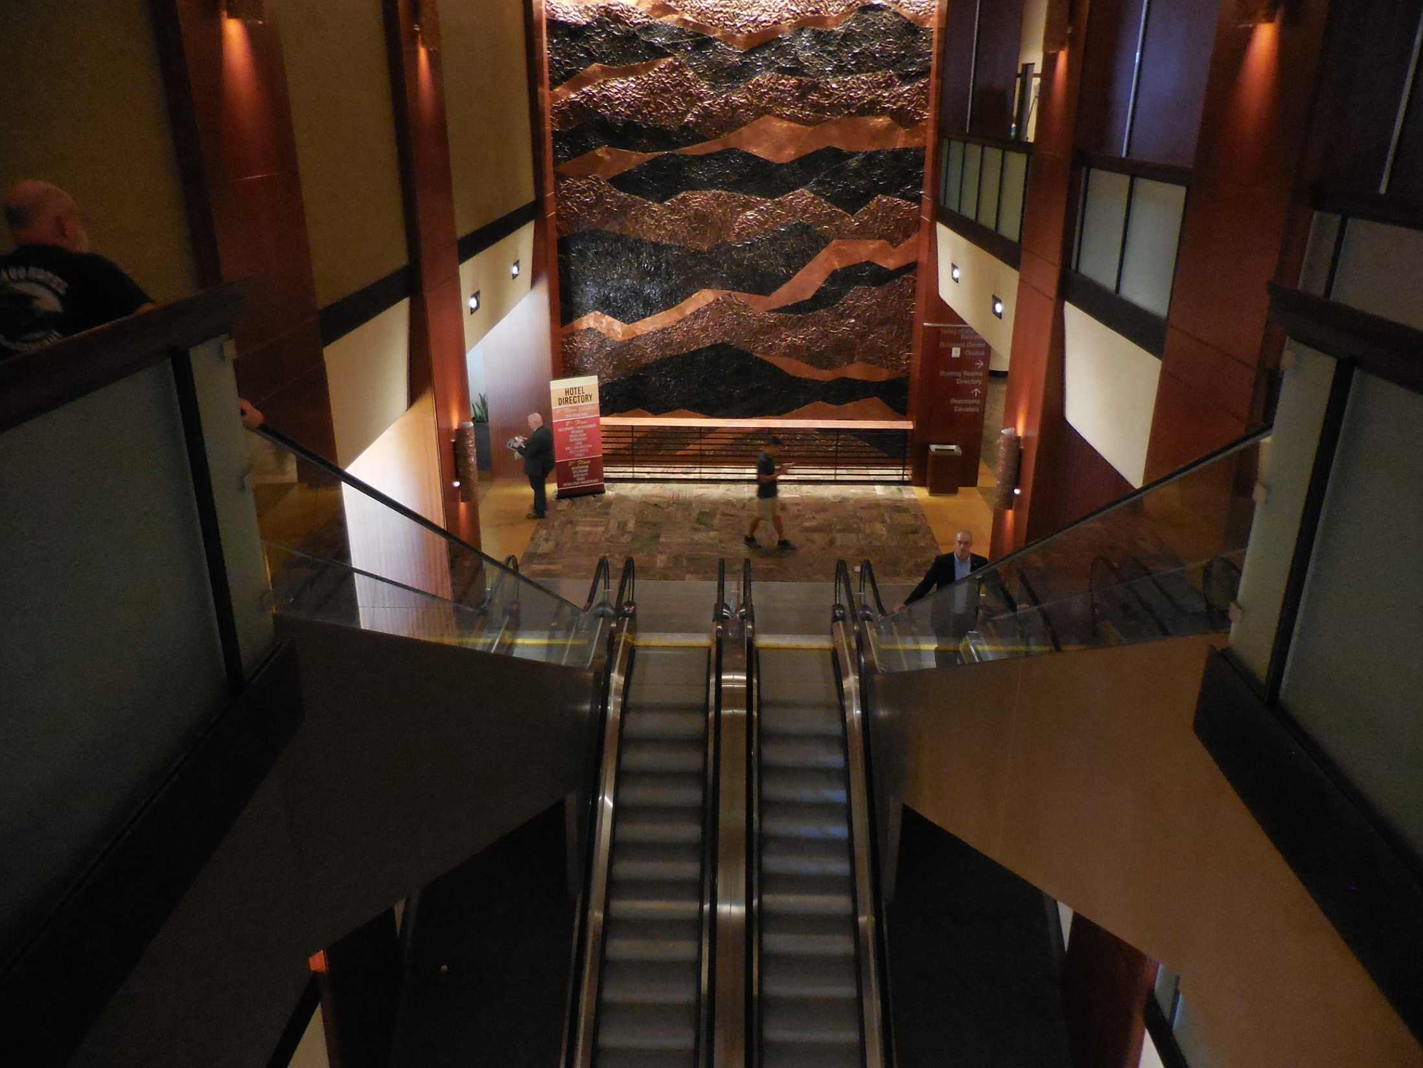

Slide 11
The AG Presentations
There were over 210 speakers for a little over 280 meetings of various types (not all presentations, some Mensa organizational, debates, games, meet & greets, etc.). At times there were as many as 10 or more things taking place at the same time. Obviously, what is below is highly selective and no doubt somewhat biased.

Slide 12
Black Legend: George Bascom, Cochise,
and the Start of the Apache Wars
In 1861, Lieutenant George Bascom confronted Cochise concerning the return of a stolen boy, Felix Ward, and his stepfather’s livestock. In 1869, a self‑promoting officer, Reuben Bernard, started the story that Bascom had done something wrong and that he, Bernard, was a hero who had tried to prevent it. Since then, “popular historians” have blamed Bascom for 11 years of warfare with the Apache. The real story is much more interesting and kinder to Bascom. It includes the story of a flying stagecoach, of the first Medal of Honor, and of Felix Ward, who returned to notice in 1872 as an Apache scout called Mickey Free. For more information, see doughocking.com or email doug@doughocking.com.

Slide 13
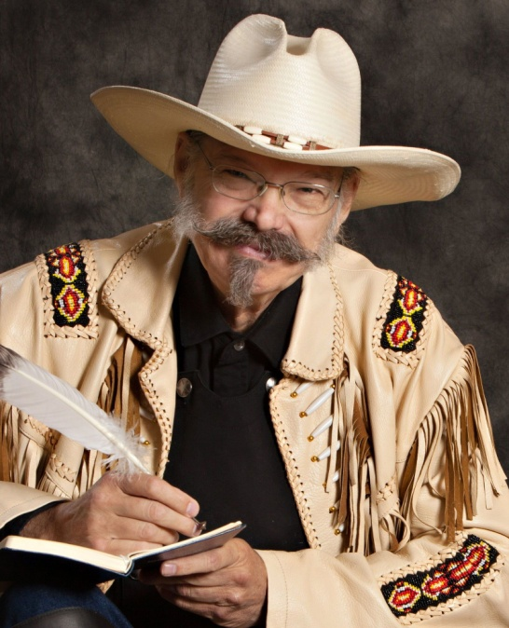
Biographical Sketch An award‑winning author and speaker, Doug Hocking is an independent scholar who has completed advanced studies in American history, ethnology, and historical archaeology. After growing up among the Jicarilla Apache and paisanos of the Rio Arriba (northern New Mexico), Doug served as an NCO in military intelligence, retiring as an Armored Cavalry officer. He is also a board member of the Arizona Historical Society.

Slide 14
Comments Hocking is the author of several books, including The Black Legend, Tom Jeffords: Friend of Cochise, Massacre at Point of Rocks, Mystery of Chaco Canyon, and more. Hocking grew up on a reservation, lives in southeast Arizona, where he has frequently visited the site of Forts Buchanan and Breckenridge, Cochise’s Stronghold, Johnny Ward’s Ranch, and Apache Pass seeing them through the eyes of historian, ethnographer and archaeologist. The stories of Cochise are largely fiction, and it is very difficult to discover the truth. According to Hocking, Cochise was a great and forward-looking leader. Hocking is a very good story teller, and his presentation was very interesting.

Slide 15
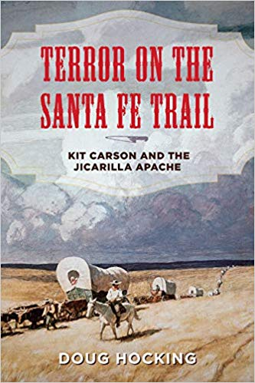
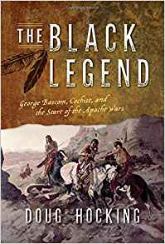

Slide 16
The Lost Dutchman Gold Mine: Fact, Fiction, and Legend
The Lost Dutchman is perhaps the most famous lost gold mine in American history. The mine is named after German immigrant Jacob Waltz (c. 1810–1891), who purportedly discovered it in the Superstition Mountains during the 19th century and kept its location a secret until his death. People have been searching for the Lost Dutchman’s mine since at least 1892. According to one estimate, 8,000 people annually participate in the hunt, and it hasn’t been found yet…. You could be the one! Come and hear this fascinating tale of mystery, a buried treasure, and, some say, murder, under the blazing Arizona sun.

Slide 17
Biographical Sketch Larry R. Hedrick, a frequent speaker on the Superstition Mountains and the Lost Dutchman Mine, is co‑founder of the Superstition Mountain Historical Society. Widely traveled, and originally hailing from Oklahoma, Larry settled permanently in Arizona in 1966. He also founded and commands the Seventh U.S./CS Cavalry, a civil war reenactment organization, which has been seen in several television documentaries and motion pictures. Larry’s research has been accepted by prominent Arizona historians, and he has taught a class in Civil War history, sponsored by Central Arizona College. You can contact him at larryhedrick75@gmail.com.

Slide 19
Jacob Waltz was born in Germany around 1810 and immigrated to America around 1839. Shortly before his death in 1891 he had supposedly revealed some details as to where he had a very rich gold mine in the Superstition Mountains of Arizona, but he left no map. Much speculation about where the mine might be has flourished ever since. Hundreds of people look for it annually, and many people have died trying. Hedrick’s talk documented some of this history. See the Superstition Mountain Museum web site for more details: http://superstitionmountainmuseum.org See the very interesting and well-made 25-minute video documentary: https://www.youtube.com/watch?v=9Exby919-hI

Slide 21
Things No One Told You About Space Exploration. There Have Been Challenges That Have Never Been Published.

Slide 22
Abstract Dr. Bob Breault, Ph.D., looks like a normal person. He is not. Bob started out as a fighter pilot in the Vietnam War. He left the Air Force and after getting a Ph.D. in space optics at the University of Arizona and became one of the world’s leading experts in the invention and operation of software for space telescopes, from the Hubble to the Giant Magellan. This session will be moderated by one of his fighter pilot buddies, Maj. Gen. USAF (Ret.) Don Shepperd. Both are part of a Tucson lunch group called “The Friday Pilots,” a group of pilots who flew the old airplanes in the old Air Force. The session will be conducted as an interview, with the moderator asking Bob questions and probing for answers. They will address some of the history of space research and about what really happened, and Bob’s answers should be fun to hear! Bob has been exposing the Friday Pilots on some of the latest findings in space research. Dr. Breault has spent most of his life since 1954 penetrating the unknowns of the origin of the universe with the pioneers in the field. Much of it did not evolve as it is recorded.

Slide 23
Major General Donald W. Shepperd retired from the Pentagon in 1988 as head of the Air National Guard. A combat veteran who flew 247 fighter combat missions in Vietnam, Donald served as a military analyst for CNN and militar commentator for ABC radio during wars in Iraq and Afghanistan. He is a 1962 distinguished graduate of the U.S. Air Force Academy, where he earned a master’s degree in personnel management. His book Bury Us Upside Down, about the Vietnam War, has been widely acclaimed. His latest book, The Friday Pilots, is about a group of 20 retired Tucson pilots who flew the old airplanes, in the old Air Force.

Slide 24
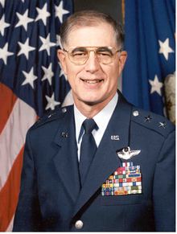

Slide 25
Dr. Robert Breault is a recognized pioneer in space‑based research. He has worked with many of the field’s trailblazers, participating in the designs of the Hubble, IRAS, DIRBE, ISO, GALILEO, CASSINI, XMM, and LIGO, as well as most of the 8 million‑plus ground‑based telescopes. He has worked one on one with six Nobel Laureates and key people in space‑based exploration.

Slide 26
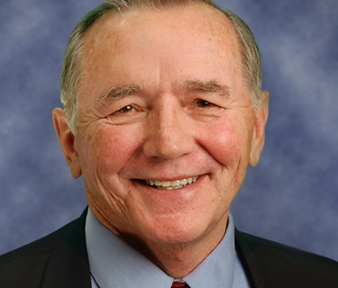

Slide 27
This was a very interesting talk primarily from Dr. Breault, reminiscing about his career in physics, primarily optics, and the implications of his work. Breault claims that due to his influence, Merriam-Webster has changed the definition of a photon. He says a photon is not a particle, the Niels Bohr model of the atom has no correlation with reality, no one knows what a photon is, and optical waves do not interfere. He also said that our galaxy is among the earliest galaxies, and that he sees no conflict between Genesis and science. He sees the space/time continuum as a complex tensor field.

Slide 28
Asteroids, Ion Propulsion, and NASA’s Dawn Mission to Vesta and Ceres
Asteroids are the primitive remains from the formation of the solar system, the building blocks of the planets, but for years they were neglected by NASA planetary missions in favor of bigger objects such as Mars and the outer gas giants Jupiter and Saturn. NASA’s Dawn mission was the first orbiter sent to Main Belt asteroids, (four) Vesta and (one) Ceres. What did Dawn discover? Join Professor David Williams of ASU’s School of Earth and Space Exploration and a member of the Dawn Science Team for a discussion of the results of the Dawn mission and what was learned about the two most massive objects between Mars and Jupiter. For more information, email David.Williams@asu.edu.

Slide 29
Biographical Sketch David A. Williams is an associate research professor in the School of Earth & Space Exploration as well as director of the NASA Regional Planetary Information Facility at Arizona State University. He researches planetary geology, with a focus on planetary mapping. He was involved with NASA’s Magellan Mission to Venus and the Galileo Mission to Jupiter. He is a co‑investigator on ESA’s Mars Express orbiter and a co‑investigator on NASA’s Psyche Mission.

Slide 31
Comments Ceres was promoted from an asteroid to a dwarf planet, and Pluto was demoted from a planet to a dwarf planet. Pluto is still a planet! Ceres revolves on its axes every 5 1/2 hours, and revolves around the sun every 4 1/2 earth-years. The Dawn mission was launched on a Delta rocket (see picture below) in 2007 propelled by ion engines (after launch). It arrived at Vesta in 2011. In 2015 Dawn went into orbit around Ceres (see picture below), the largest object in the asteroid belt (between Mars and Jupiter). Two pictures of surface details are shown below. The Dawn mission was concluded in November of 2018.

Slide 32
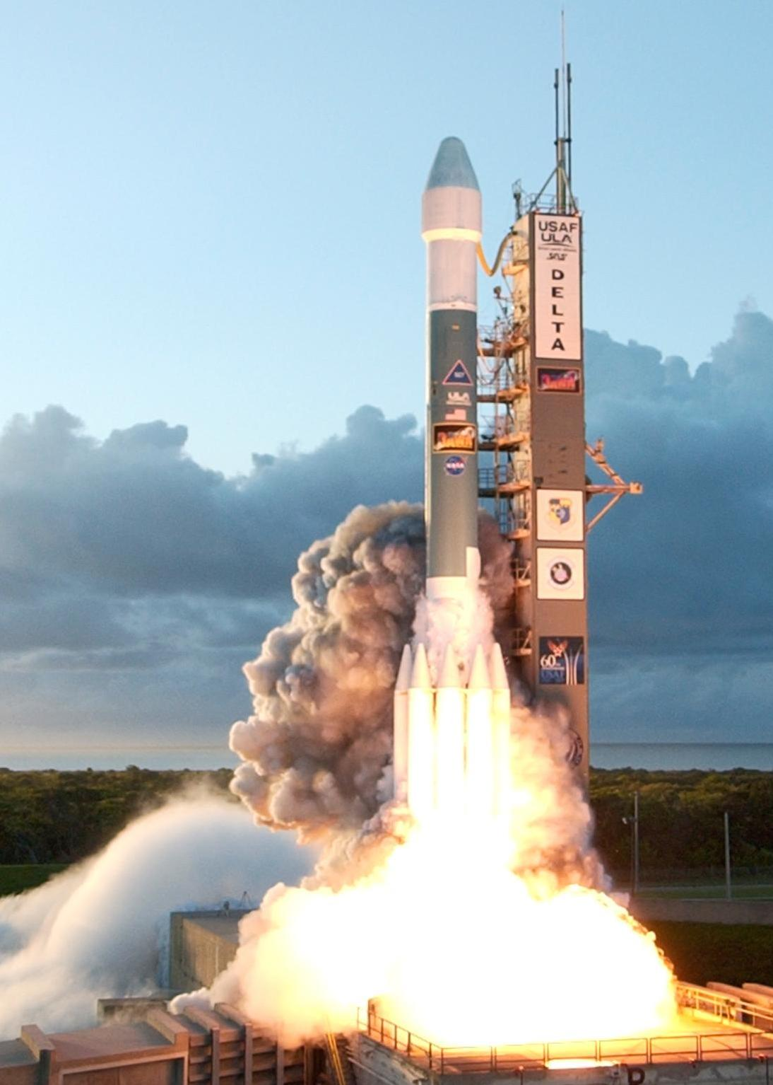

Slide 33
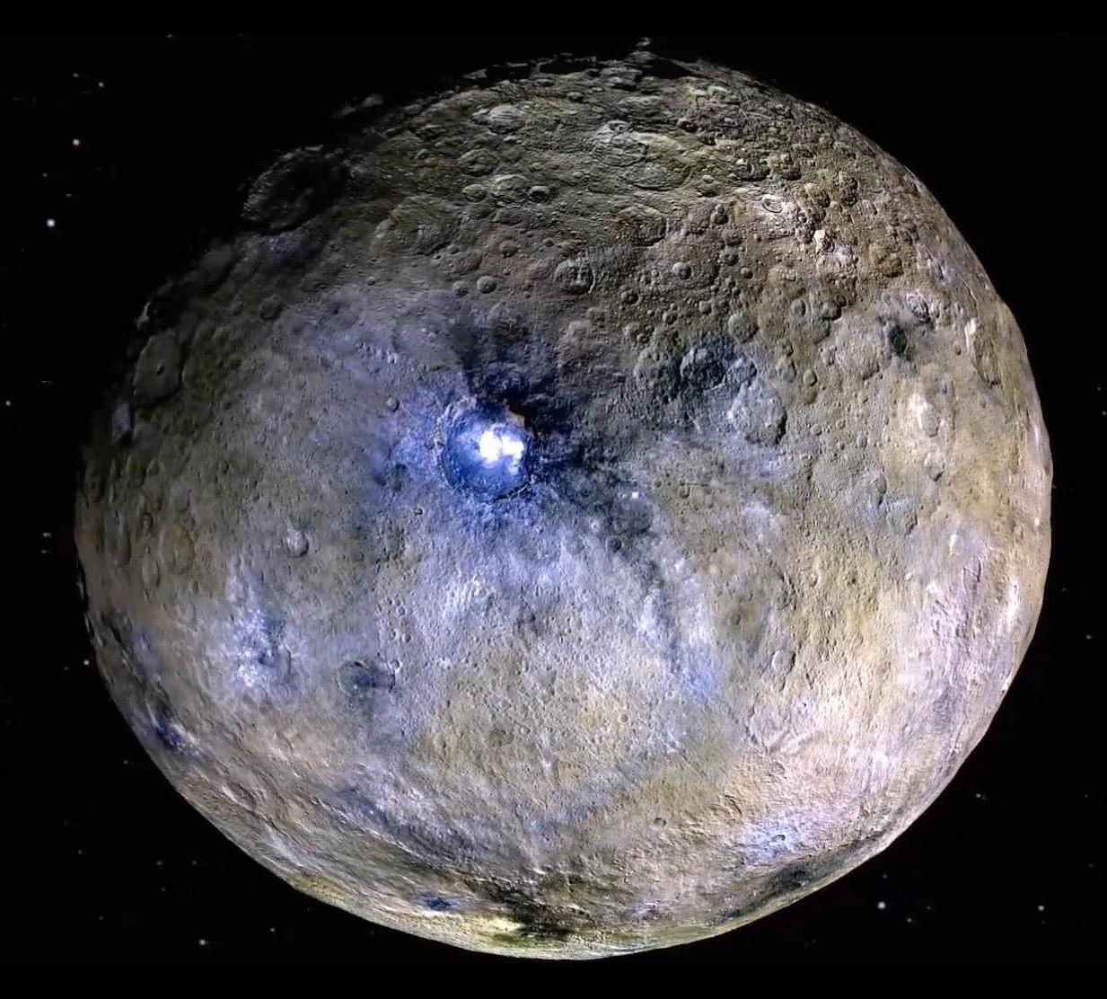

Slide 34
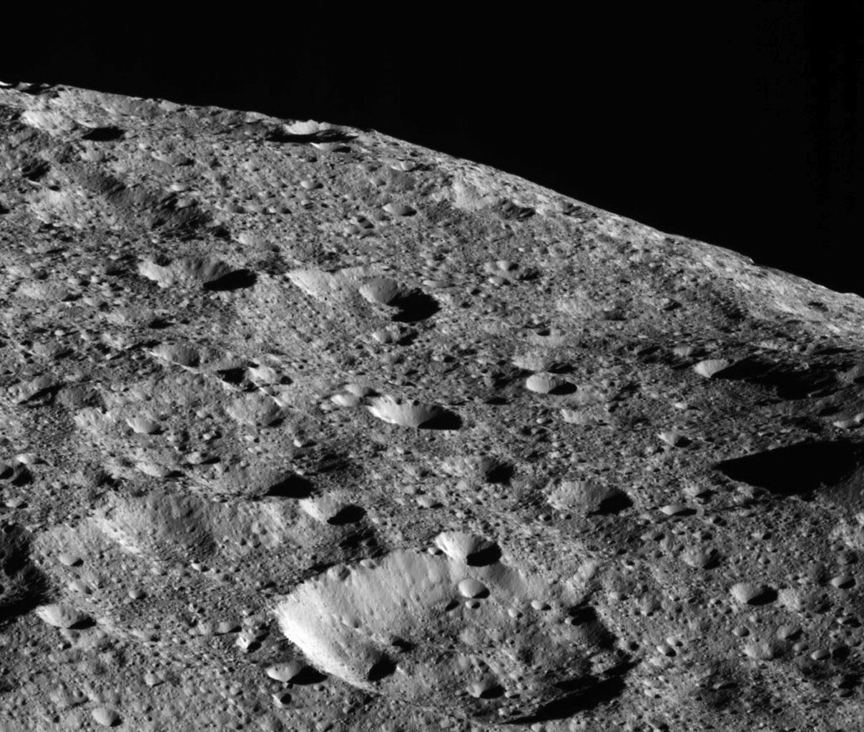

Slide 35
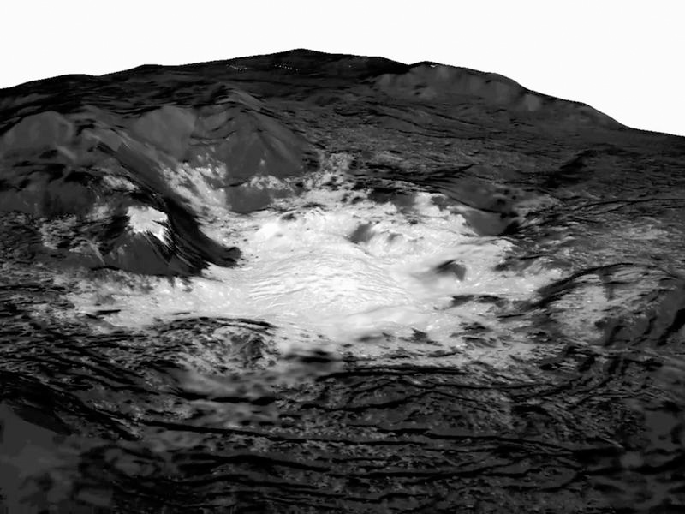

Slide 37
Kansas Sunflower Mensa Statement on Civility and Freedom of Speech DRAFT: January 11, 2020
Conversation and the free exchange of information in Kansas Sunflower Mensa (KSM) meetings is highly valued. We should all feel free to express ourselves in KSM meetings, knowing that our ideas will be welcomed and carefully considered. For many of us, this is the most important part of being in Mensa. We must be willing to entertain (or at least tolerate) the ideas of others if we also wish to have our own ideas entertained (or tolerated). If we wish others to consider what we have to say, we must, in turn, respect those to whom we are speaking, explain ourselves carefully, not expecting anyone to agree with us simply because we say it, but be able to express ourselves in a convincing way, with reasons given, and be open to entertain the questions that we receive from those listening to us. With these concepts in mind, the following guidelines are offered to enhance the free exchange of ideas in our meetings.

Slide 38
General Principles
KSM chooses to promote an atmosphere for discourse which is characterized by openness, mutual respect, and trust along with a willingness to have one’s ideas, arguments, and beliefs vigorously challenged so as to continually refine and improve them. We encourage a critical examination of competing points of view where no such view is immune to examination and challenge. It is paramount for the success of such discourse that there is a norm of not personalizing arguments with gratuitous slurs or name-calling. No participant should be excluded, humiliated, or intimidated during such discussions. No probing into clearly personal and private information that is uncomfortable for the individual involved should be permitted. It is our desire to eliminate any atmosphere of intimidation, but rather to encourage an open exchange of ideas and points of view which leads to intellectual and spiritual growth and refinement for all participants.

Slide 39
Inappropriate Content Content deemed inappropriate include the following:
● Content is inappropriate that is pornographic, or images containing nudity or graphic or gratuitous violence, where the inclusion of such contributes little, if anything, to the intellectual content of the discussion.
● Content is inappropriate that is unnecessarily long, and where most would judge that any central point has been lost. The purpose of the exchange is discussion on an agreed upon topic. We must be aware of how what we are saying is being received, with the purpose of communication.

Slide 40
● All personal attacks are inappropriate, as are inflammatory or antagonistic comments, as are comments making fun of or belittling others and/or their beliefs, age, intelligence, career choices, or credentials, etc. The focus should be on the agreed upon topic: other comments are diversionary, and do not contribute to a fair and honest discussion.
● All hostile behavior, such as bullying, is inappropriate. All such actions reveal weakness in the position of the one exercising such behavior, not the one who is being bullied.
● Ignoring requests to return to the agreed upon topic is also inappropriate. Staying on topic is a sign of intelligent discourse, and we encourage it.

